Slide 1

PROJECT MACARONI
Marketing Campaign Return Optimisation and Improvements
Gabor Jenei
24 October 2022
Photo by Hermes Rivera on Unsplash

Slide 2
Problem Overview
A previous campaign was conducted 6 months ago, where the marketing team targeted a random selection of your mortgage customer base. These customers were offered this home insurance product but only a small number of them took it out.
The marketing department has asked me to use the previous campaign data to improve the selection of candidate customers so a higher proportion will purchase the product in a future marketing campaign.
Project Macaroni | Gabor Jenei | October 2022

Slide 3
Overview Findings
The first Home Insurance campaign had 8% success rate
Using the data from the first campaign we can use machine learning to improve the success rate to 61%* in the next campaign
61%*
8%
* Between 38% and 83% at 95% Confidence Interval
Project Macaroni | Gabor Jenei | October 2022

Slide 4

HOW?

Slide 5
Data
Discovery
The solve this business problem we can use supervised learning, specifically binary classification.
The 2 tables available hold the data we require:
Mortgage table contains 32, 561rows with 18 columns of demographic information of customers with no missing values.
Issues:
- Salary column has a large number of different formats (frequency)
- No obvious ID column to join the two tables
The campaign has the ground truth data if the randomly selected participants took out an insurance. There are 32,060 rows and 16 columns. The target feature has a large number of missing values, 90% of the records have no value.
Issues:
- 90% of the target column is missing
Key data processing tasks:
Join the two tables
Clean the salary information
Project Macaroni | Gabor Jenei | October 2022

Slide 6
Data
Joining
Number of participants
In the absence of a trivial way to join the tables, I used the following process :
1. Use the name information
The way the names are represented in the two tables are different. I transformed the full_name column from mortgage table to the same structure as it appears in the three column of campaign table. (name_title, first_name, last_name).
I did a left join using the name fields. Name is not guaranteed to be unique and a left join duplicated the rows from the left table because of the 1:many relationship.
2. Use age and dob date-of-birth
age and dob date-of-birth information to reduce the number of duplicate participants. The year of dob + age should be around the year when the campaign was ran +/- 1 year.
3. Use the postcode and town information
to further reduce any remaining duplicated participants. The post area part of a postcode is unique to a town.
4. Check if there's any duplicated participant_id left and drop these.
3,027
3,686
2,987
Project Macaroni | Gabor Jenei | October 2022

Slide 7
Data
Cleaning Salary information
The salary information was in a single column in many different formats (currency, frequency, band or single value) :
'£18109 yearly’
'£729.87 pw’
'£15062 - 27299 range'
'60406468.73ANG’
Using python and pandas string manipulation capabilities:
1. Separate frequency indicators into a frequency column
2. Separate currency into a separate column
3. Assign digits to a lower and upper bound columns
4. Extract Currency conversion information from the internet
5. Assume frequency conversion factors to frequency indicators
6. convert values to a median GBP per annum
Project Macaroni | Gabor Jenei | October 2022

Slide 8
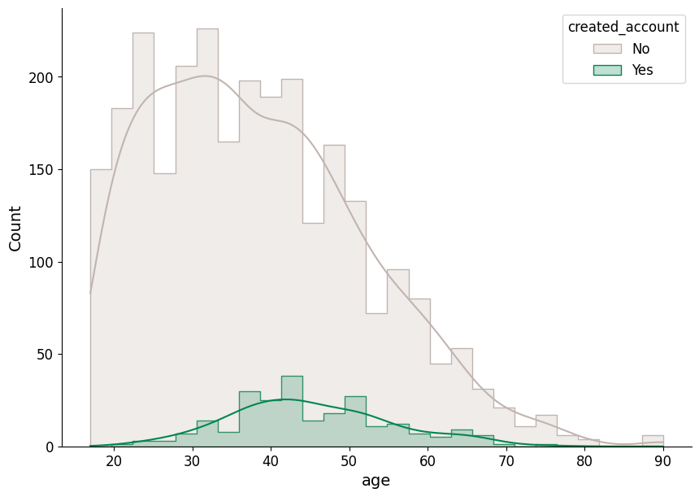
Exploratory Data Analysis
Age
Older generation was more receptive to take out an insurance than younger customers. The average age of the customers not buying the home insurance is 38 years with a right skewed distribution. The average age of the customers buying the home insurance is 45 years.
Project Macaroni | Gabor Jenei | October 2022

Slide 9
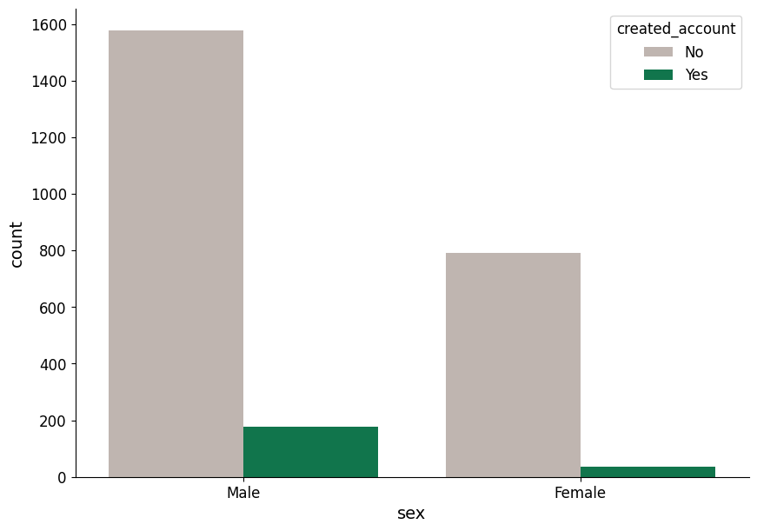
Exploratory Data Analysis
Gender
4% of the Female customers took out insurance, whilst this value is 10% for Male customers.
Project Macaroni | Gabor Jenei | October 2022

Slide 10
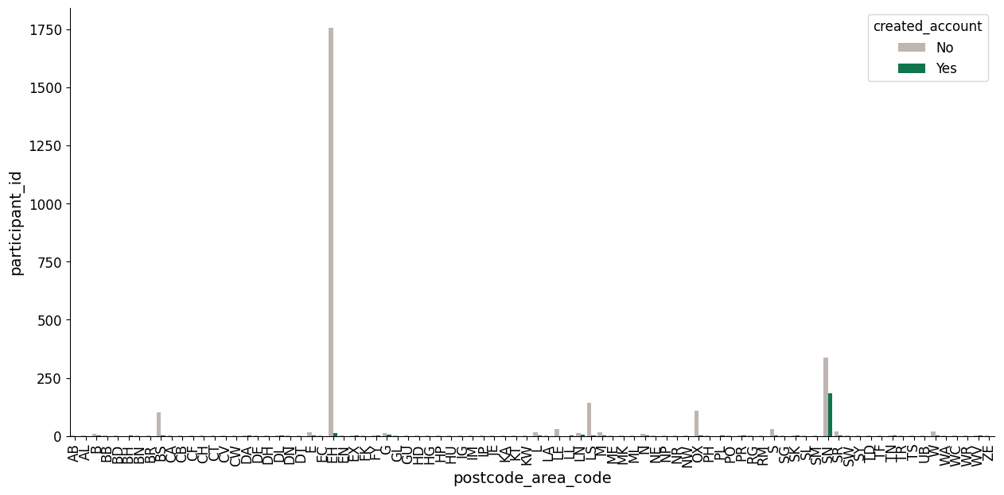
Exploratory Data Analysis
Geographic Location
The data shows a great geographic variance. The campaign approached the most people in Edenborough with 0.8% success rate. The best performing location is Swindon with 35% success rate.
Project Macaroni | Gabor Jenei | October 2022

Slide 11
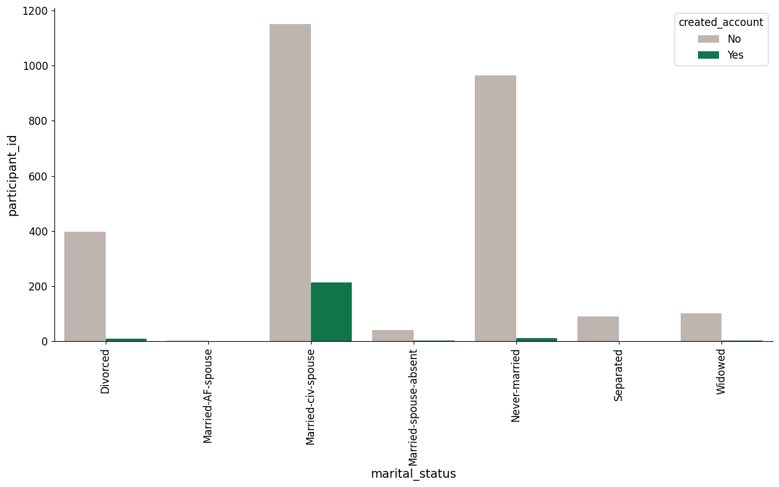
Exploratory Data Analysis
Marital status
16% of Married-civ-spouse customers took out home insurance. The groups with no spouse present have a below average success rate
Project Macaroni | Gabor Jenei | October 2022

Slide 12
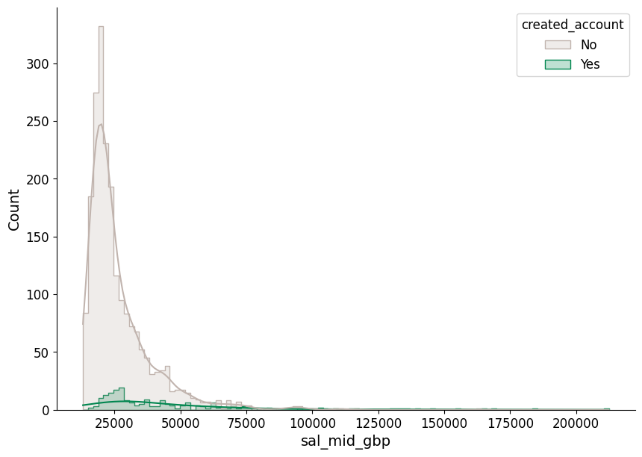
Exploratory Data Analysis
Salary (after cleaning)
The average wage of the customers not buying the home insurance is £26,658 pa with a heavily right skewed distribution. The average salary of the customers buying the home insurance is £47,185 pa. The pattern looks similar to what we seen with age feature. There may be a correlation between age and salary (wouldn't be surprising)
Project Macaroni | Gabor Jenei | October 2022

Slide 13
Modelling
Features
I selected features available or can be derived from the mortgage table – practical significance.
The selection of features can be an iterative process.
Feature | Type
age | numeric, continuous
sex | categorical with 2 values - as Boolean 0/1
religion | categorical, non-ordinal one-hot encoding
relationship | categorical, non-ordinal one-hot encoding
education | categorical, ordinal encoded with integers
occupation | categorical, ordinal encoded with integers
time_with_employer | numeric, continuous
hours_per_week | numeric, continuous
sal_mid_gbp | numeric, continuous
new_mortgage | categorical with 2 values - as Boolean 0/1
created_account | categorical with 2 values - as Boolean 0/1
Project Macaroni | Gabor Jenei | October 2022

Slide 14
Modelling
Approach, Considerations
The problem requires a binary classification approach
The target variable is imbalanced.
Imputing missing values can improve model performance.
To mitigate this I applied 2 strategies:
Stratified Train-Test Split
Random Over Sampling of Minority Class
Pre-processing:
Nominal categorical: One-hot encoding
Ordinal categorical: increasing integer encoding
Numerical: Standard Scaler
I used Sklearn Pipeline objects to structure the pre-processing and modelling steps
Train-Test Split
Train data
Test data
Fit Pipeline:
Pre-processing
Model
Predict using fitted Pipeline
Evaluate Precision
Project Macaroni | Gabor Jenei | October 2022

Slide 15
Modelling
Model Selection
I have trained with Sklearn default settings five models
Support Vector Classifier (SVC),
Decision Tree Classifier (DecisionTreeClassifier),
Random Forest Classifier (RandomForestClassifier),
Naive Bayes (GaussianNB),
Logistic Regression (LogisticRegression)
There’s a lot more model specification with different settings to try and empirically determine which performs the best. These can be neural networks (with a SoftMax at the last layer) or xgboost, etc.
Project Macaroni | Gabor Jenei | October 2022

Slide 16
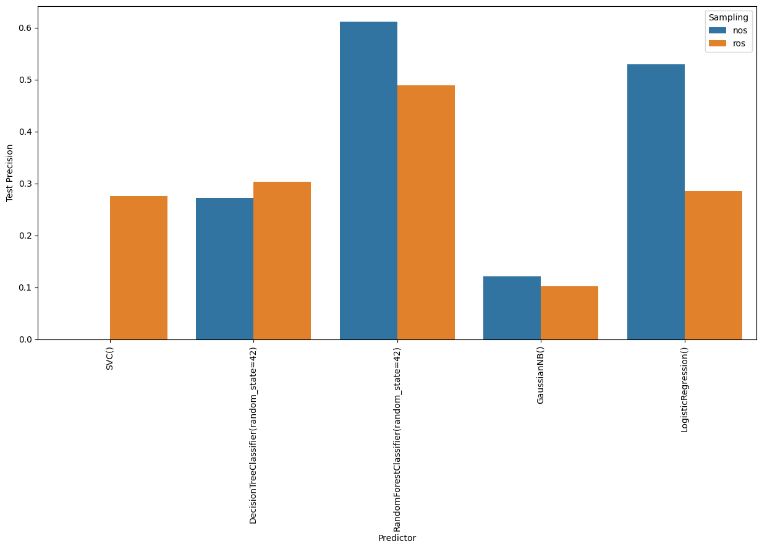
Modelling
Best Model
Because of the imbalanced dataset, accuracy as a metric to measure how well the model performs is misleading. A dummy model predicting only 0 would be 92% accurate.
For optimising the marketing campaign, the best evaluation metric to look at is the Precision.
The best performing model on the test set, measured by Precision is the Random Forest Classifier trained on the dataset with no oversampling.
Precision: 0.61
F1-score: 0.31
These customers would take a home insurance out but the campaign won’t reach them
If we only target customers we predict to buy, the success rate only includes these customers
Random Forest Classifier Confusion matrix |  | Predicted
 |  | No Home Ins. | Home Ins.
Actual | No Home Ins. | 584 | 7
 | Home Ins. | 43 | 11
Project Macaroni | Gabor Jenei | October 2022

Slide 17
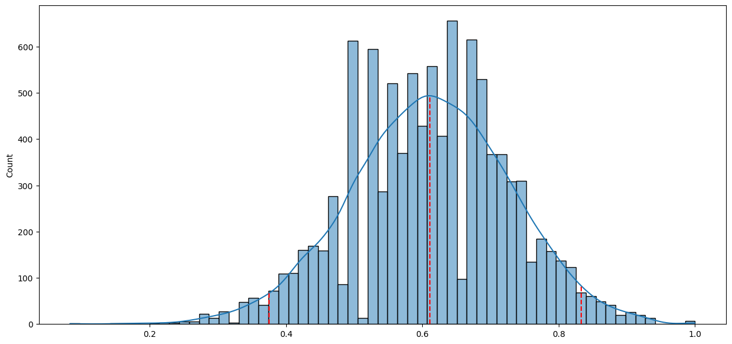
Modelling
Prediction Interval
We only tested our model on a small set of data.
To have a better feel of how the success rate may vary on a different sample I calculated confidence intervals using bootstrapping. The confidence level used is 95%.
The lower limit is 38%, the upper limit is 83%.
Even a pessimistic scenario is likely to be better than random selection in the first campaign.
Project Macaroni | Gabor Jenei | October 2022

Slide 18
Productionise & Deployment
For productionising the model the notebooks need to be refactored to a modular and programmatically callable code base following software engineering best practices.
I applied some of these scaled down to the available time frame
well structured (packaged), documented (doc-strings, comments, readme), modular code split into functions
unit-tests of the functions
source control (git)
For the next campaign we want to score existing mortgage customers. This would suit a batch inferencing service best.
Going forward we can consider using this on every new mortgage customer. This would suit a real time inferencing service best.
Both of these can be easily implemented in Azure ML (and probably other services as well) as a web API receiving and returning html requests.
Project Macaroni | Gabor Jenei | October 2022

Slide 19

Thank you

